Slide 1

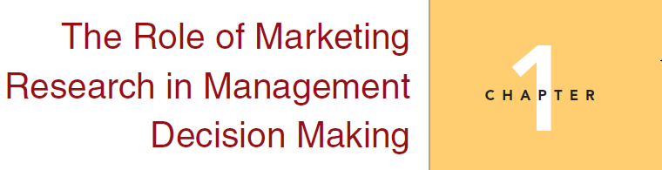
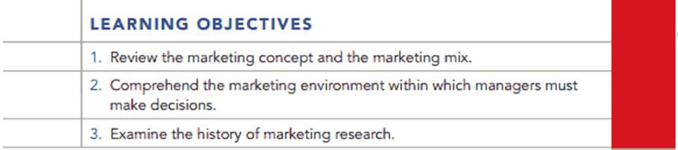
Chapter 1

Slide 2
Question
Comment on the following statement by the owner of a restaurant in a downtown area: “I see customers every day whom I know on a first-name basis. I understand their likes and dislikes. If I put something on the menu and it doesn’t sell, I know that they didn’t like it. I also read the magazine Modern Restaurants, to keep up with industry trends. This is all of the marketing research that I need to do.”

Slide 3
Answer
This restaurant owner may know customers by name, but the assertion about understanding their tastes may be over-confident. An item on the menu may not sell because the customers are not familiar with it. Or, it may be perceived as too expensive. There could be many reasons why a product might not sell as well as the owner wants it to. By conducting marketing research, the owner could better determine the preferences of customers and potential customers. This would save the money, effort, and time of changing the menu selection. While a national magazine can determine national trends in the restaurant business, these trends are not always completely applicable at the local level. Marketing research could help the owner become familiar with the favorite foods in the local geographic market.

Slide 4
Question
Marketing research has traditionally been associated with manufacturers of consumer goods. Today an increasing number of organizations, both profit and nonprofit, are using marketing research. Why do you think this trend exists? Give some examples.

Slide 5
Answer
Marketing research helps all organizations follow the principle of the “marketing concept.” Profit-making organizations face increasing amounts of competition from U.S. companies, as well as from global companies. Also, both profit-making and nonprofit organizations are serving an increasingly diverse clientele. Marketing research helps to identify target customers and their needs in a rapidly changing environment.

Slide 6
Question
What differences might you note among marketing research conducted for (a) a retailer, (b) a consumer goods manufacturer, (c) an industrial goods manufacturer, and (d) a charitable organization?

Slide 7
Answer
A retailer might use marketing research to track trends in demographics, to determine effective advertising strategies, and to find products or services desired by the customer.
A consumer goods manufacturer might use marketing research to help determine the probability of success of a new product or to keep current on its competitors’ activities and success. It might also use it to ascertain the best target market for current products.
An industrial goods manufacturer might use marketing research to project future needs of customers or to determine the level of products that will be demanded.
A charitable organization might use marketing research to determine what services are most needed in a demographic target market and to find the most effective vehicle for delivering those services. It might also use marketing research to identify potential donors and to find the most effective way to appeal to them.

Slide 8
Question
Comment on the following: Ralph Moran is planning to invest $1.5 million in a new restaurant in Saint Louis. When he applied for a construction financing loan, the bank officers asked whether he had conducted any research. Ralph replied, “I checked on research and a marketing research company wanted $20,000 to do the work. I decided that with all the other expenses of opening a new business, research was a luxury that I could do without.”

Slide 9
Answer
If Mr. Moran is willing to spend $1.5 million on a new restaurant without conducting marketing research, he should be prepared to lose that money. Without marketing research, he may not know his potential customers or their desires. Nor will he know if those desires or needs are currently being met by existing businesses, or at what price or quality level the customers would be willing to try a new restaurant. His advertising may be at best ineffective or at the worst offensive. For example, what if he were to advertise barbecue pork ribs in an area that is predominantly Jewish? Given all of this, $20,000 seems a small price to pay to increase the chances of success of a business with so large an investment.

Slide 10
Question
What is meant by “return on quality”? Why do you think that the concept evolved? Give an example.

Slide 11
Answer
Return on Quality means two things. First, that the quality being delivered is the quality desired by the target market. Second, that added quality must have a positive impact on profitability. The concept may have evolved because of the large number of quality programs that were begun in the 1980’s and 1990’s which did not improve the financial position of the companies who started them. National Bank Corporation, mentioned in the text, measures every improvement in service quality in terms of added profitability.

Slide 12
Question
Given an example of (a) the descriptive role of marketing research, (b) the diagnostic role of marketing research, and (c) the predictive function of marketing research.

Slide 13
Answer
An example of the descriptive role of marketing research is a bank or other financial institution performing research to determine the demographics of its customers.
An example of the diagnostic role of marketing research is the bank using the demographics of customers and the demographics of the area population to determine if a certain age group needs to be targeted with promotion.
If the bank uses the information gathered above, the predictive function of marketing research should allow it to predict the reaction of the target group to the advertising and the percentage increase in new accounts.

Slide 14
Question
Read case 1.1- Give Me a Coupon That I Can Use Online!
Answer the following questions:
1. How might a firm like Home Depot use this information? Would Amazon.com use the same couponing strategy as Home Depot?
2. Do you think that Home Depot might need more research before it develops a couponing strategy? If so, what does it need to know?
3. Do you think it is necessary for online retailers to conduct marketing research?
Why?

Slide 15
Answer
Home depot could use an in store application for smart phones. The smart phone would display coupons that could be used for that day to purchase this kind of products Amazon.com should have coupons appear when items are transferred to the purchase cart online
2. Yes. Home depot should analyze how many of its customers use in store coupons from their smart phones.
3. Yes. Online retailers should conduct marketing research and correlate the consumer decision process with the usage of online coupons.

Slide 16
Question
Read Case 1.2 -- Can Anyone be a Market Researcher?
Questions
Go to Google’s Consumer Survey website. After clicking through how it works, and examples, do you feel competent to create an Internet survey? Why or why not?
Do you think the marketing research industry should be concerned about Google Consumer Surveys? Why?

Slide 17
Answer
The Google Consumer Survey method is easy to understand and use, because it is well designed and menu driven.
2. Yes, because Google has a methodology which possibly gives its survey method the ability to infer demographic information to its surveys without asking demographic questions.

Slide 18
Question
Most traditional consumer surveys conclude with a series of demographic questions such as gender, age, location, and so forth. Google Consumer Surveys don’t ask these questions. Instead it infers approximate demographic and location information using the respondent’s IP address and DoubleClick cookie.
The respondent’s nearest city can be determined from their IP address. Income and urban density can be computed by mapping the location to census tracts and using census data to infer income and urban density. Gender and age group can be inferred from the types of pages the respondent has previously visited in the Google Display Network using the DoubleClick cookie.
Google says that is information is used to ensure each survey receives a representative sample and to enable survey researchers to see how sub-populations answered questions. Inferring this demographic data enables Consumer Surveys researchers to ask fewer questions in a survey, which in turn increases the number of consumers that respond.
Do you think this methodology is better than simply asking the demographic questions? Do you see any problems with Google’s methodology?

Slide 19
Answer
It depends upon how good is Google’s method algorithm for estimating demographics. Shorter questionnaires historically have higher response rates than longer questionnaires.
Google uses a number of factors such as IP addresses and DoubleClick cookies to map respondent location. Then Google infers demographics from based on the average demographics for a given “mapped” area. This method would be effective for a survey covering a large geographic area with few responses from any one area. However, if the survey is limited to a small geographic area, the effect of the average demographic may not be a valid representation of the respondent(s) in question.

